Slide 1

RPA for Ariba Network: Build Your Own Bot Around Ariba Network
INT163
Vijay G & Moumita Bera, SAP

Slide 2
RPA for Ariba Network: Build Your Own Bot Around Ariba Network
INT163
Vijay G & Moumita Bera, SAP

Slide 3
Disclaimer
The information in this presentation is confidential and proprietary to SAP and may not be disclosed without the permission of SAP. Except for your obligation to protect confidential information, this presentation is not subject to your license agreement or any other service or subscription agreement with SAP. SAP has no obligation to pursue any course of business outlined in this presentation or any related document, or to develop or release any functionality mentioned therein.
This presentation, or any related document and SAP's strategy and possible future developments, products and or platforms directions and functionality are all subject to change and may be changed by SAP at any time for any reason without notice. The information in this presentation is not a commitment, promise or legal obligation to deliver any material, code or functionality. This presentation is provided without a warranty of any kind, either express or implied, including but not limited to, the implied warranties of merchantability, fitness for a particular purpose, or non-infringement. This presentation is for informational purposes and may not be incorporated into a contract. SAP assumes no responsibility for errors or omissions in this presentation, except if such damages were caused by SAP’s intentional or gross negligence.
All forward-looking statements are subject to various risks and uncertainties that could cause actual results to differ materially from expectations. Readers are cautioned not to place undue reliance on these forward-looking statements, which speak only as of their dates, and they should not be relied upon in making purchasing decisions.

Slide 4
Agenda
Onboard to SAP Intelligent RPA Trial
Create a trail Account to get start.
Introduction to SAP Intelligent RPA
what is RPA and Overview of SAP Intelligent RPA tool
Use case overview
Overview of business process that we will automate
Developer Resource
Details documentation and Bot store

Slide 5

Introduction to SAP Intelligent RPA

Slide 6



What is RPA?
Robotic Process Automation (RPA)
accelerates digital transformation of business processes by automatically replicating tedious actions to free up human workers for more high-value tasks.
Unattended: Fully automated process, where robots are working autonomously with human supervision only
Attended: Partially automated process, where robots are co-working with humans, also called Robotic Desktop Automation (RDA)
Notes:
Unattended:
Deployed on server​, Trigger-based​, Skip manual processes​, Automate a whole process
Example:
Purchase Orders are sent to an inbox and have to be read, identified, information has to be taken and brought into ERP system to create the PO reference. A bot can run the full process autonomously.
Attended:
Deployed on user workstation​, Launched by user​, Ease manual processes​, Automate a part process​
Example:
An insurance clerk is called by a customer who has an accident. He doesn’t want to click through X different systems to get to his data, however, wants to have an overview/dashboard of the results of many sub steps needed to get the required data.

Slide 7





How SAP Intelligent RPA solution delivers Business Value
Improve operations
Mobilize resources for high-value tasks at lower costs
Increase compliance
Maintain well-documented audit trails
Increase service quality
Reduce processing times for revenue generating transactions
Reduce human errors
Automate to gain speed and efficiency
Notes:
Further Business Benefits:
Improve the process efficiency, saving time
Improve the process quality, reducing errors
Improve the user satisfaction and pride, removing boring tasks from the process
Reinforcing compliance, introducing validations & auto-reporting
Cut the process execution time, generating immediate savings
Allow parallelization and immediate scalability
Introduce brand new technology without any footprint on the legacy
Offer an alternative to APIs, web services and classical connections
Prevent long and expensive development

Slide 8

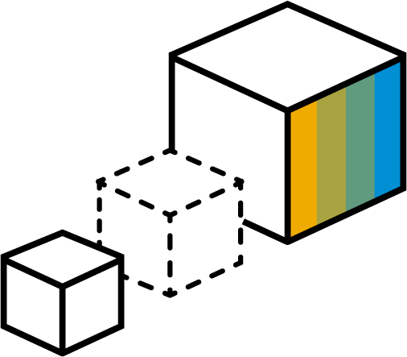






Design, run, orchestrate & monitor SAP and non-SAP applications
SAP Applications
Design
with Studio
SAP Intelligent RPA
Run with Agents
Integration via UIs and APIs. Servers and desktops.
Non-SAP Applications
Third-party tools
Legacy applications
Web applications
Internet portals
Orchestrate and Monitor
with Cloud Factory

Slide 9
Get start with SAP Intelligent RPA

Slide 10

SAP Intelligent RPA Trail
SAP Intelligent RPA Trial
A free trial landscape to try automating your scenarios with SAP Intelligent RPA
Up to 600 jobs can be executed during the trial period
Up to 20 cloud projects can be created
Up to 2 environments can be created
Up to 2 agents can be active at the same time
Step by Step Guide to create trial account https://help.sap.com/viewer/82d5a2499d8449dda691bb4d5b3d7949/Cloud/en-US

Slide 11
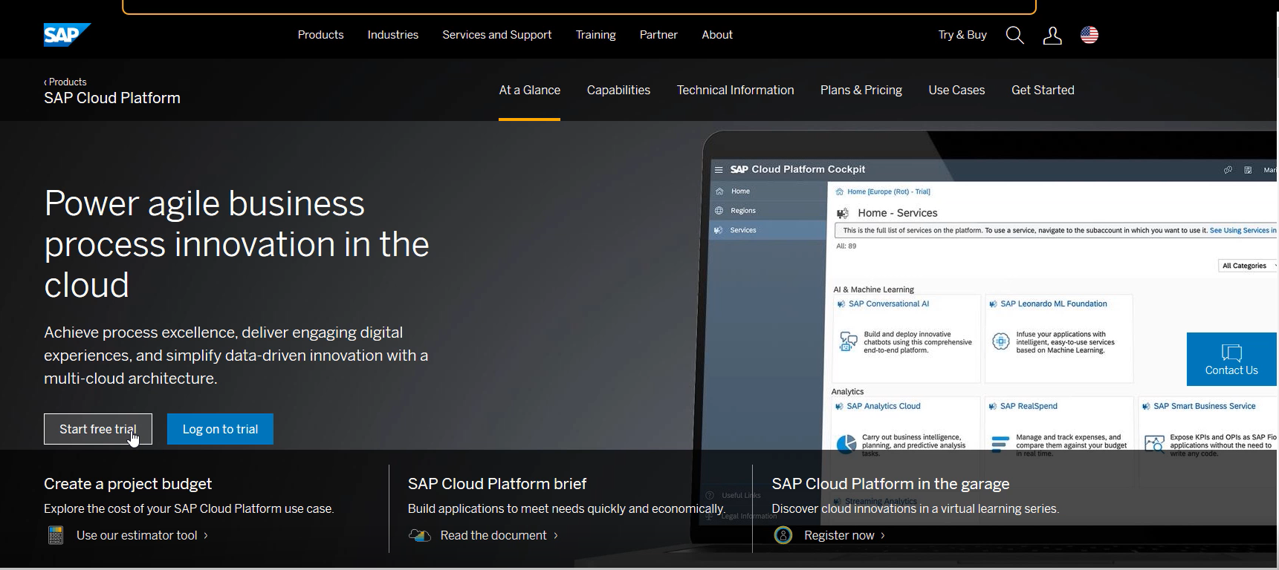

Onboard to SAP Intelligent RPA Trial
Self-onboard to SAP Intelligent RPA Trial: https://help.sap.com/viewer/product/IRPA/Cloud/en-US

Slide 12
Overview of use case

Slide 13

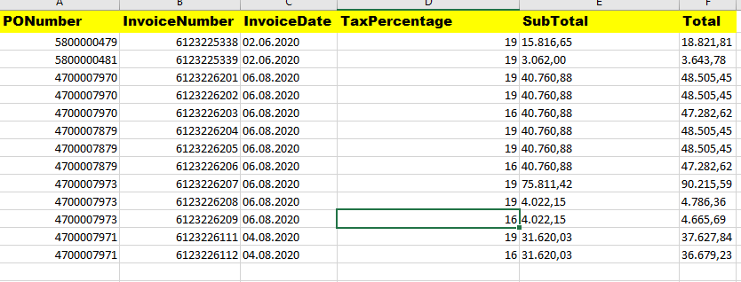
Flip Purchase Order in SAP Ariba
Open an excel file which contains several purchase order (PO) details
Read excel data in SAP Intelligent RPA
Login to SAP Ariba system
Search for PO number. If search is successful, then upload PO pdf and submit in Ariba System else send a business exception email.

Slide 14
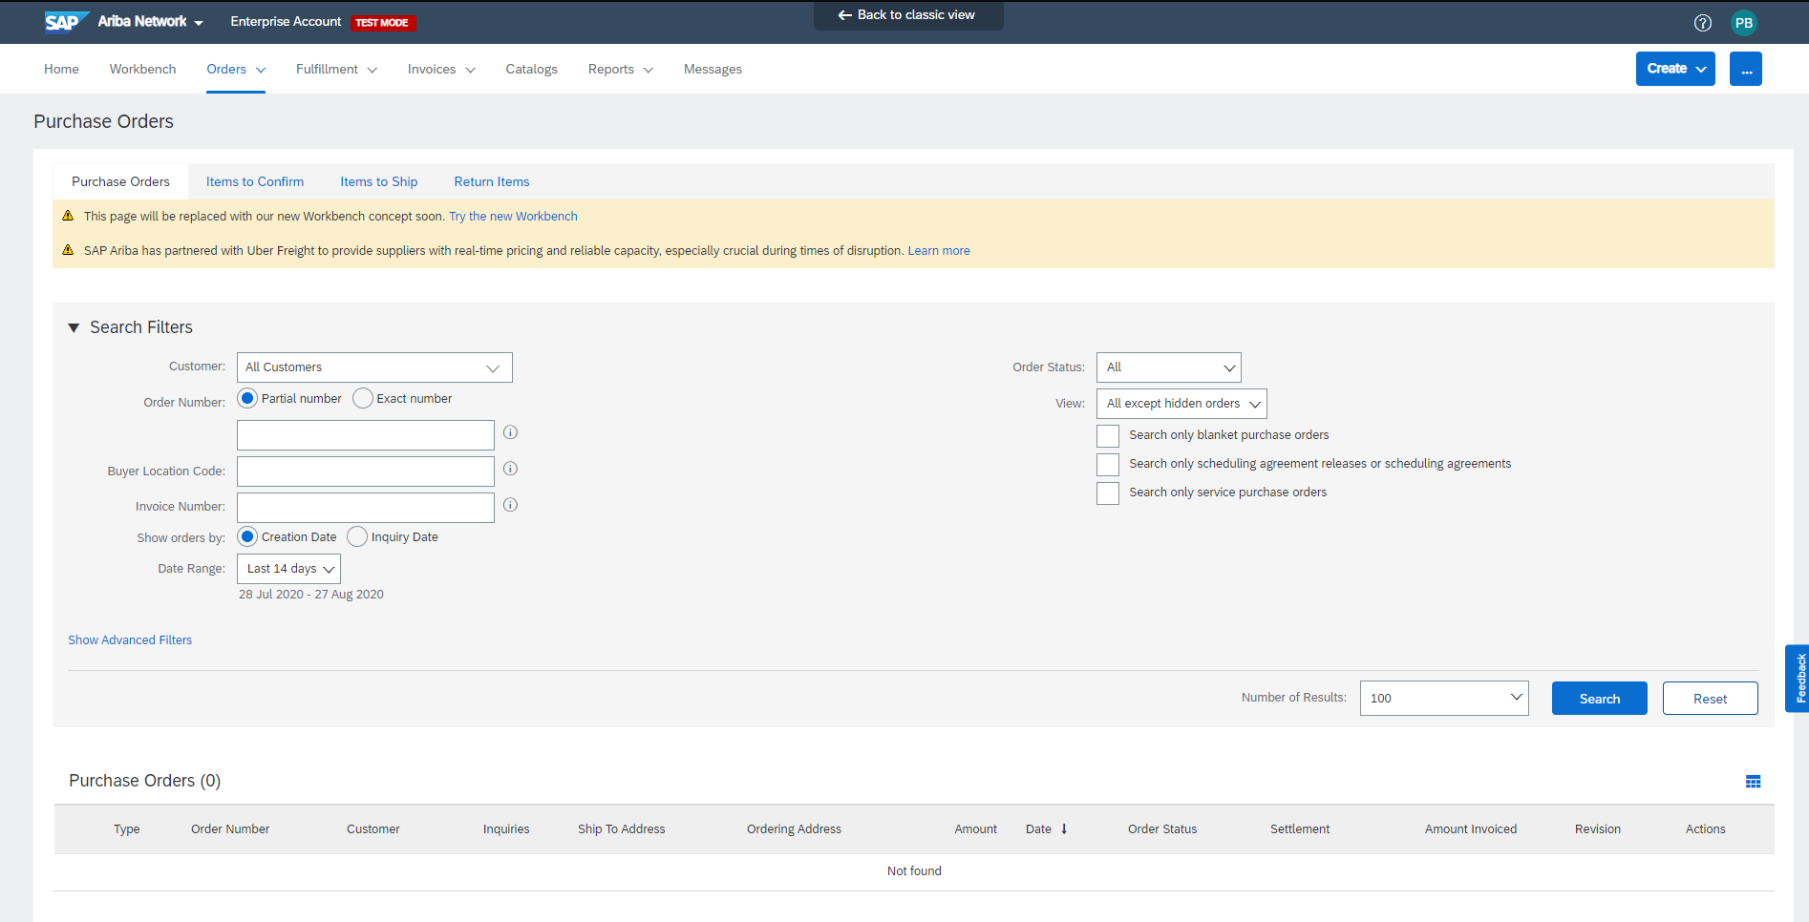
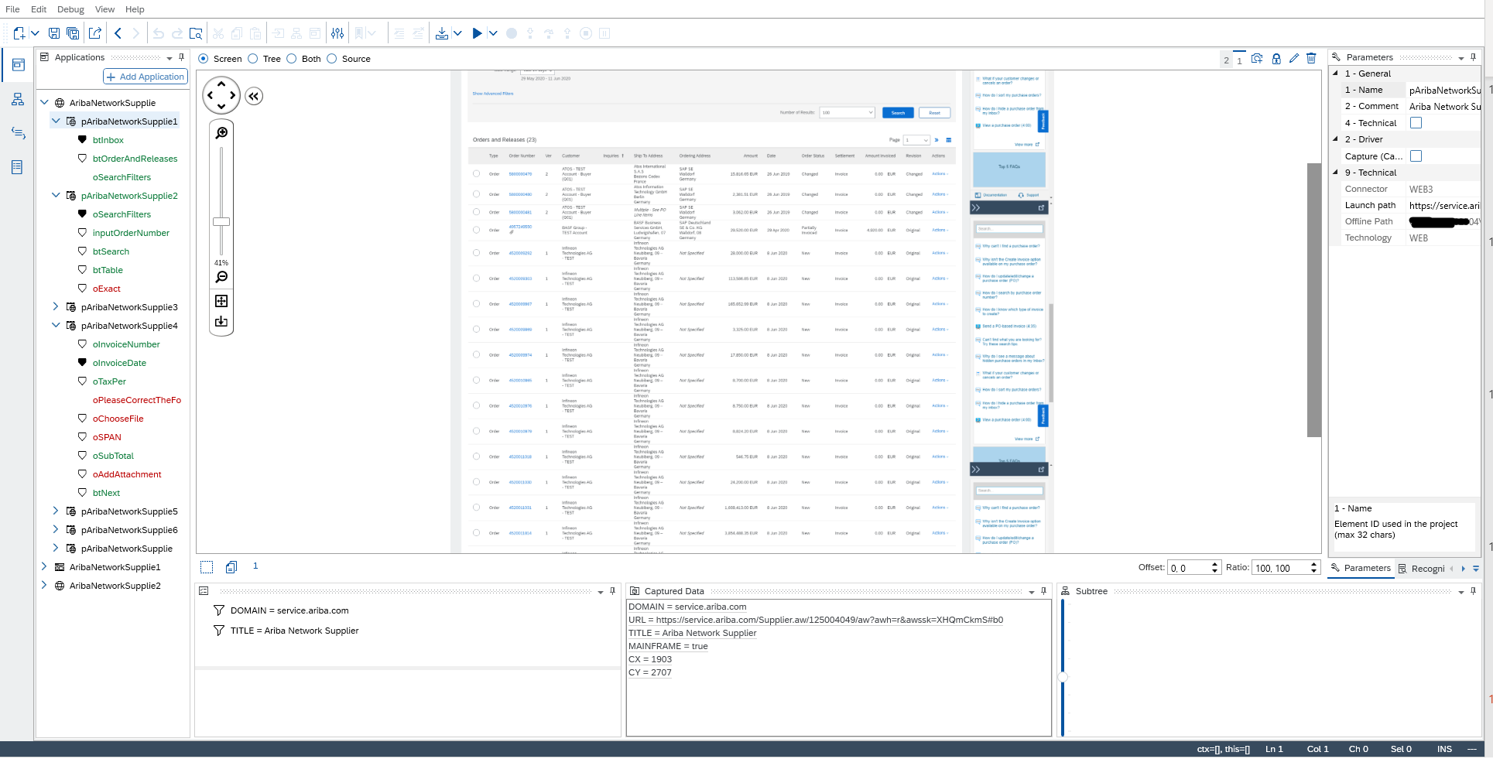
Application declaration
Desktop Studio: Explorer
Capture SAP Ariba Application
Declare the pages and items involved in the Flip Purchase Order (PO) process

Slide 15
Build workflows
Desktop Studio: Workflow Designer
Data structure
Create a Purchase Order Data Context (pass information between Excel & SAP Ariba system)
First workflow
Read purchase orders details from an Excel file
Second workflow
Process a Purchase Order (PO) in SAP Ariba System
Key takeaways
Be able to use office tools in your RPA project development
Apply best practices to batch Job creation in Factory

Slide 16



More resource for developer and business
Developer Guide
Documentation and active Developer Community
Ready-to-Use/Competitive Offering
Bot Templates for SAP S/4HANA and ECC
Cross-LoB content/SAP-best practices as pre-packaged bots available on SAP Intelligent RPA Store
CUSTOMER

Slide 17
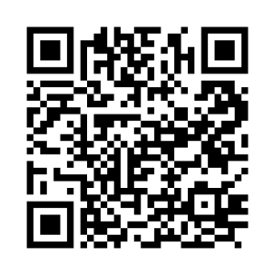





Get started
Share knowledge​ on SAP Community
Try for Free
Buy Online on SAP Store 15% off with code TECHED15* *Valid through February 28, 2021, some restrictions apply
Follow our Social Channels
SAP_RPA
SAPRPA
SAPIntelligentRPA

Slide 18

More information
Related SAP TechEd sessions
INT118 All Your Processes in Your Hand: The World of Business Activity Monitoring INT122 Simplified Bot Building: Experience New Cloud-Based, Low-Code Bot Building INT165 RPA As Easy As 1-2-3: Low-Code Design for Microsoft Office and SAP Software INT202 OCR & Machine Learning based Surface Automation. Your truly intelligent RPA INT822 Road Map: SAP Intelligent Robotic Process Automation
Public SAP Web sites
SAP Community: community.sap.com/topics/intelligent-rpa SAP Products: www.sap.com/rpa SAP Store: www.sapstore.com/solutions/42831/SAP-Intelligent-Robotic-Process-Automation SAP Intelligent RPA Bot Store: https://store.irpa.cfapps.eu10.hana.ondemand.com/ OpenSAP courses: open.sap.com/courses?q=rpa

Slide 19
SAP Intelligent RPA
rpa@sap.com

